Slide 1
Machine Learning for Beginners
Michaela Webster
Developer

Slide 2
What is machine learning
Machine Learning, at its most basic form, is the practice of using algorithms to parse data, learn from it, and then make a determination or prediction about something in the world.
https://becominghuman.ai/ai-machine-learning-deep-learning-explained-in-5-minutes-b88b6ee65846

Slide 3
Cool Examples of Machine Learning
Amazon Echo and Google Home
Email spam and Malware
Medical Diagnoses
Recommendation engines

Slide 4
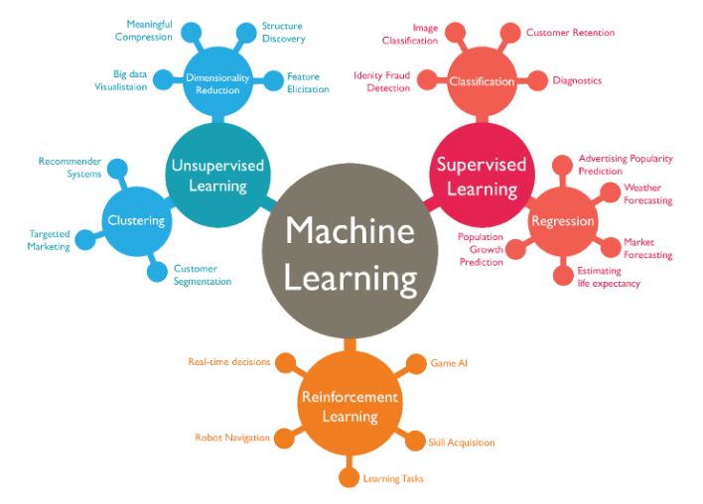

Slide 5
Why use machine learning
Saves time and money
Removes the human aspect
Easily identifies trends/patterns
Improves over time
Automation

Slide 6
When not to use machine learning
Not enough data
Not enough time/resources
Problem is not complex enough to need ML
You know the rules
Low error tolerance

Slide 7
Machine learning terminology
Features: attributes that a model uses to predict an outcome
Label: the field we are trying to prediction (supervised)
Training data: data used to teach the model
Test data: data used to test the model
Model: a mathematical algorithm that “learns” from training data
Metrics: measures to explain the performance of the model

Slide 8
How Does the Process Work?
Understand the problem and the data
Know it
Clean it
Augment it
Categorize the problem
Supervised
Unsupervised
Reinforcement
Understand the constraints
Size
Time
Find an algorithm(s)
https://hackernoon.com/choosing-the-right-machine-learning-algorithm-68126944ce1f

Slide 9
Supervised vs unsupervised vs Reinforcement
Depends on the problem
Dependent or Independent?
Depends on data
Type of input
Labels?
Type of Outcome

Slide 10
Supervised methods
Every input is independent and has an associated label: f(x) = y
2 main groups:
Classification: output is a category (“red”, “denied”, “infected”, etc.)
Regression: output is a real value ($, weights, etc.)
Example: object recognition

Slide 11
Unsupervised methods
Every input is independent and has no associated label: f(X) = ???
2 main groups:
Clustering: want to discover the inherent groupings in data (ex: group customers by purchasing behavior)
Association: want to discover rules that describe large portions of data (ex: people that buy A also tend to buy B)
Example: image processing

Slide 12
Reinforcement Methods
Every input is dependent on the previous input and decision
2 main groups:
Positive: an event happens due to a particular behavior which then increases the strength and the frequency of the behavior
Negative: strengthening of a behavior because a negative condition is stopped or avoided
Example: Chess

Slide 13

Which solution is right for my problem?
https://scikit-learn.org/stable/tutorial/machine_learning_map/index.html

Slide 14
Demo
Full code for demo can be found at https://github.com/mawebster9/MachineLearningMadeEasy
We will focus on Supervised Machine Learning for this demo – particularly the Classification method

